Slide 1







www.avantio.com
FROM CHAOS TO FLOW
SIMPLIFYING AUTOMATION WITH ARGO WORKFLOWS
TU FOTO AQUÍ
José Smiller
Software Engineer
Avantio
Connectivity
Notes:
"Hello everyone, thank you for your time and thank you to the people of Valencia Codes for having me today. My name is Jose Smiller and today I'll be giving a presentation titled From Chaos to Flow, where we would dive into workflow automation with Argo Workflows."

Slide 2
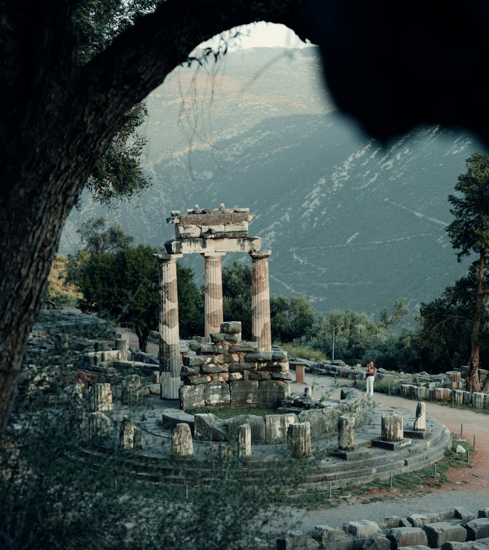
TU FOTO AQUÍ
José Smiller
Software Engineer
Avantio
Connectivity
Define workflows and the relevance of workflow orchestration
Associate challenges and common issues with unmanaged workflows
Identify the benefits of using workflow management systems
The Prophecy
What knowledge will you acquire?
Notes:
A little bit about me, I am a Web Developer at Avantio, specifically in the connectivity department. I have worked as a Full Stack Developer most of my career, but recently graduated from a Masters Degree in Cloud Computing. This is where I got to learn about cloud-related technologies as I did my final project on Workflow Orchestration with Argo Workflows.

Slide 3
www.avantio.com
Agenda/Index
TU FOTO AQUÍ
1
Prologue
2
Chaos
Define workflows and the relevance of workflow orchestration
Associate challenges and common issues with unmanaged workflows
Identify the benefits of using workflow management systems
3
The Battle
José Smiller
4
The Three Labors
Software Engineer
Avantio
Connectivity
The Prophecy
What knowledge will you acquire?
5
The Flow
6
The Paths Beyond
Notes:
Let's start by defining the scope of this presentation. For this presentation, we will define workflows and the relevance of workflow orchestration through some examples. We will associate the challenges and common issues that are present in unmanaged workflows. We will also identify the benefits of using workflow management systems for workflow automation.

Slide 4
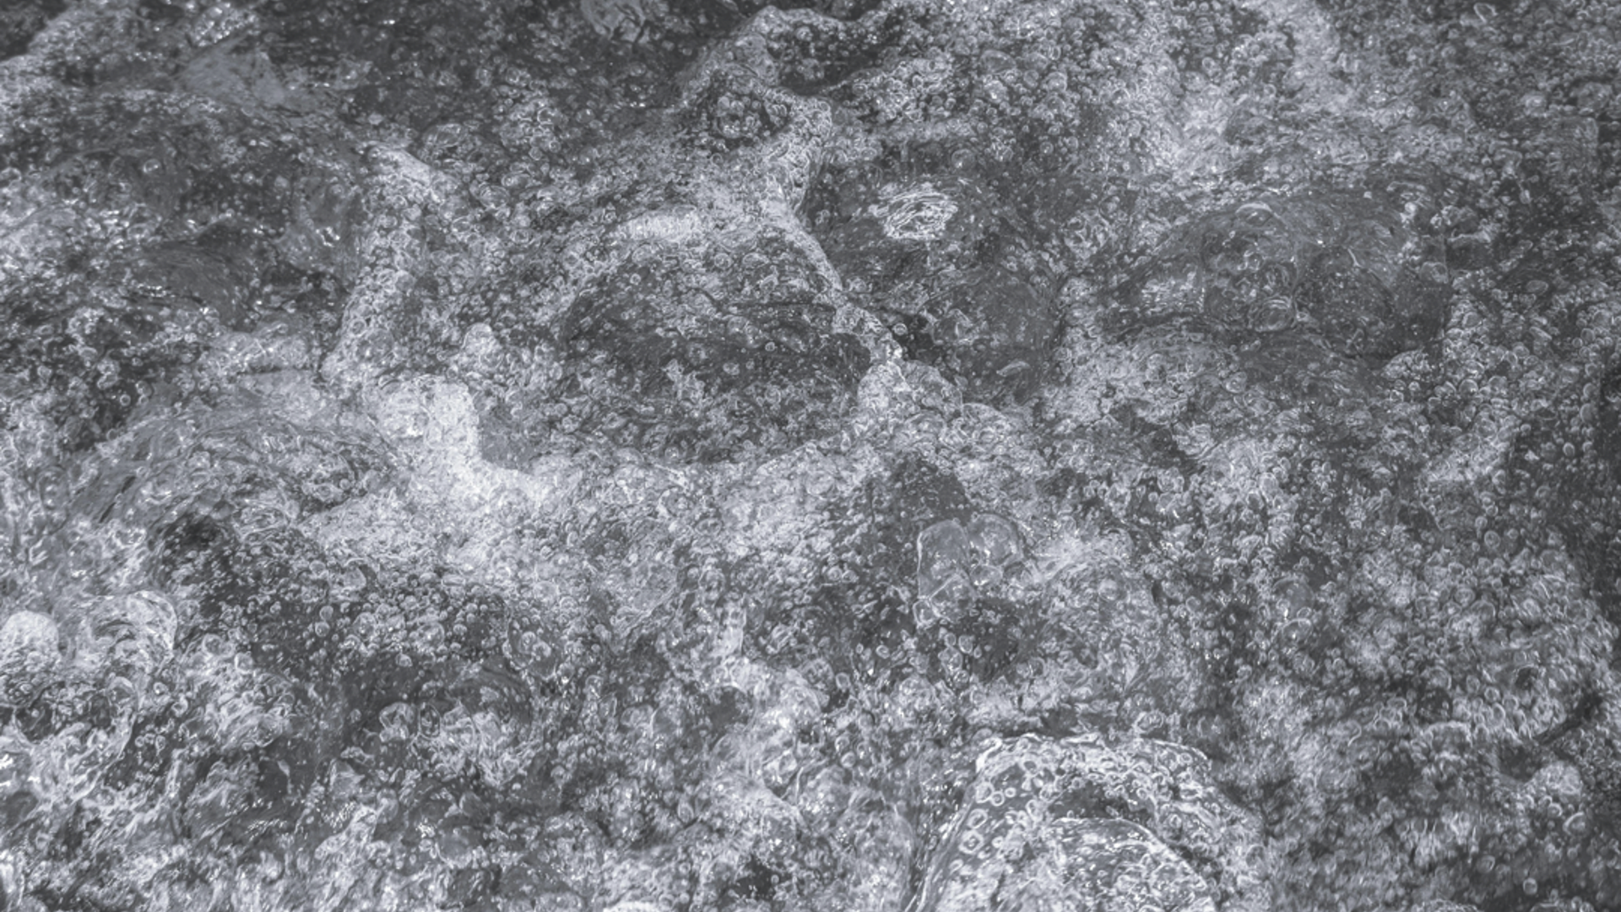
www.avantio.com
1
Agenda/Index
1
Prologue
2
Chaos
Define workflows and the relevance of workflow orchestration
Associate challenges and common issues with unmanaged workflows
Identify the benefits of using workflow management systems
3
The Battle
4
The Three Labors
The Prophecy
What knowledge will you acquire?
5
The Flow
Prologue
The Age Before Order
6
The Paths Beyond
1
Prologue
The Age Before Order
Notes:
DONE

Slide 5


www.avantio.com
Agenda/Index
1
Prologue
2
Chaos
3
The Battle
4
The Three Labors
5
The Flow
6
The Paths Beyond
1
Prologue
The Age Before Order
What is a workflow?
A workflow is a defined sequence of steps or tasks (often with dependencies) that achieve a specific outcome.
Task 2
Task 1
Task 4
Task 5
Task 3
Generic workflow represented as a DAG
Notes:
Before diving into workflow orchestration, let's define what a workflow is and talk about workflow management.

Slide 6


1
Prologue
The Age Before Order
Unmanaged workflows
What is a workflow?
The workflow exists as a defined sequence of steps, but the execution is done manually and is mostly unsupervised.
A human or external process has to:
A workflow is a defined sequence of steps or tasks (often with dependencies) that achieve a specific outcome.
Task 2
Start the tasks manually
Keep track of dependencies
Handle failures and retries themselves
Task 1
Task 4
Task 5
Task 3
>_
Generic workflow represented as a DAG
Notes:
What is a workflow? A workflow can be defined as a sequence of steps or tasks, often with dependencies, that achieve a specific outcome. Workflows are a part of our daily days, both personal and professional, from cooking a meal, to developing a new feature or onboarding a new employee. Here we can see a generic example of a workflow, represented as a Directed Acyclic Graph. This example represents a workflow with order, direction and parallelism.
Q: Can anyone here point out a dependency in this generic example? R: There are múltiple dependencies in this example, the task 2 and 3 are dependent on task 1 to be finished, task 4 depends on tasks 2 and 3, and task 5 depends on task 4
Q: Can anyone point as well the direction or order of the workflow in this example? R: The order points that this workflow will be executed from right to left, indicated by the arrows connecting the tasks in the workflow
Q: Finally, can someone point the parallelism described in this workflow? R: The workflow defines that task 2 and 3 can be executed in parallel

Slide 7





What is a workflow?
Unmanaged workflows
Managed workflow
A workflow is a defined sequence of steps or tasks (often with dependencies) that achieve a specific outcome.
The workflow exists as a defined sequence of steps, but the execution is done manually and is mostly unsupervised.
A human or external process has to:
The workflow execution is controlled by an orchestrator/engine
The system automatically handles among other things:
Task 2
Scheduling and running tasks in the right order
Collecting logs and metrics
Start the tasks manually
Keep track of dependencies
Handle failures and retries themselves
>_
Task 1
Task 4
Task 5
Retrying failed tasks
Cleaning up resources
Task 3
Generic workflow represented as a DAG
Notes:
Unmanaged or manual workflows can exist in many forms and shapes, they are usually executed manually by a human or an external process, but left unsupervised for the most part of the process. In practice, an unmanaged workflow might look like a documented process (a checklist or sequence of steps) that a team follows by hand, a script of sequential shell commands that you run line by line, etc.

Slide 8


Unmanaged workflows
Managed workflow
The workflow execution is controlled by an orchestrator/engine
The system automatically handles among other things:
The workflow exists as a defined sequence of steps, but the execution is done manually and is mostly unsupervised.
A human or external process has to:
Scheduling and running tasks in the right order
Collecting logs and metrics
Start the tasks manually
Keep track of dependencies
Handle failures and retries themselves
>_
Retrying failed tasks
Cleaning up resources
MANAGED
UNMANAGED
"The system runs this for me, end-to-end".
"I have the steps written down, but I'm responsible for executing them correctly".
In brief
Notes:
With managed workflows, you submit a workflow definition or request a workflow execution, and the system manages the entire lifecycle of the workflow for you.

Slide 9

Managed workflow
The workflow execution is controlled by an orchestrator/engine
The system automatically handles among other things:
Scheduling and running tasks in the right order
Collecting logs and metrics
Retrying failed tasks
Cleaning up resources
MANAGED
UNMANAGED
"The system runs this for me, end-to-end".
"I have the steps written down, but I'm responsible for executing them correctly".
In brief
Notes:
In brief, with unmanaged workflows you are responsible for executing them correctly, while in managed workflows a systems handles the execution end-to-end for you."

Slide 10
MANAGED
UNMANAGED
"The system runs this for me, end-to-end".
"I have the steps written down, but I'm responsible for executing them correctly".
In brief
2
But as in every epic, the peace on the void was short-lived.
Chaos would take form and it would test us…
Chaos
The Wrath of Unmanaged Workflows
A fatal flaw
Lack of automation introduces the chance of human error at every step
Test fail
Missing
Push wrong image
No rollback
Code commit
Run tests
Build image
Push image
Restart app
dependencies
Manual CI/CD Pipeline: What could go wrong?
1
2
Notes:
Of course, it might be difficult to automate every single workflow in our lives, there simply is not enough time or resources to do that. But it's important to recognize that leaving workflows completely unmanaged comes with risks. Without oversight processes can become inconsistent, mistakes can creep in and bottlenecks can grow. In the worst cases, this can lead to chaos to take form and impact your operations.
In Greek Mythology, Chaos is the primordial void, the first state of existence before order was formed. It does not mean Chaos in the modern sense of disorder, but more like an unformed, unmanaged potential. Chaos as a concept is not inherently negative, it's a circumstance where creation and growth can happen, but over time, without structure, it becomes unpredictable and hard to control outcomes. In the same way, an unmanaged workflow tends to chaos: the steps exist, but without orchestration. Potential is present, yet without guidance, results become inconsistent.

Slide 11

2
Chaos
The Wrath of Unmanaged Workflows
A fatal flaw
Chaos Unleashed
Lack of automation introduces the chance of human error at every step
01
02
03
Manual triggers everywhere -> Low scalability
No failure handling -> Weak resilence
No dependencies management -> Low reliability
Test fail
Missing
Push wrong image
No rollback
Code commit
Run tests
Build image
Push image
Restart app
dependencies
04
No asynchronous tasks coordination -> Low efficiency
05
Manual CI/CD Pipeline: What could go wrong?
Poor state management -> Low visibility
Notes:
Nowadays, CI/CD pipelines tend to be automated trough tools like Jenkins or ArgoCD, this because it substracts human error from the pipeline and provides a solution that adds visibility and reliability. Let's see an example of how what can go wrong in an unmanaged CI/CD pipeline.

Slide 12
Code commit
Run tests
Build image
Push image
Restart app
Code commit
Test fail
Build image
Push image
Restart app
Code commit
Run tests
Missing
Push image
Restart app
dependencies
Code commit
Run tests
Build image
Push wrong image
Restart app
Code commit
Run tests
Build image
Push image
No rollback
Notes:
What could go wrong?

Slide 13
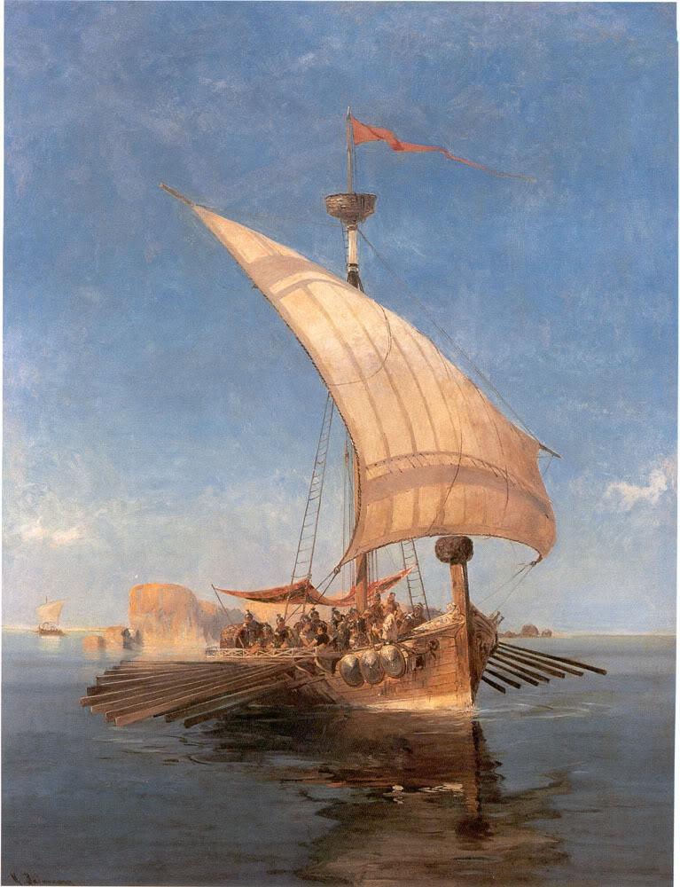
A fatal flaw
Chaos Unleashed
Lack of automation introduces the chance of human error at every step
01
02
03
Manual triggers everywhere -> Low scalability
No failure handling -> Weak resilence
No dependencies management -> Low reliability
Build image
Push image
No rollback
Code commit
Run tests
Restart app
04
No asynchronous tasks coordination -> Low efficiency
05
Manual CI/CD Pipeline: What could go wrong?
Poor state management -> Low visibility
Argo by Konstantinos Volanakis
Notes:
Some of the issues that arise with unmanaged workflows are:
Poor state management, which leads to a lack of visibility and control
Manual triggers everywhere, resulting in low scalability and high overhead
No asynchronous task coordination that can result in bottlenecks and fragile processes
No dependencies management, causing low reliability and auditability gaps
No failure handling, resulting in silent errors and low resilience

Slide 14
Chaos Unleashed
3
01
02
03
Manual triggers everywhere -> Low scalability
No failure handling -> Weak resilence
No dependencies management -> Low reliability
Every epic needs a hero, and in this story the hero brings, not a sword, but ✨ orchestration powers ✨
04
No asynchronous tasks coordination -> Low efficiency
05
Poor state management -> Low visibility
The Battle
Rise of Argo
Argo by Konstantinos Volanakis
Notes:
Once we understand the challenges and consequences of having unmanaged workflows, let's talk about one alternative to using workflow management systems...

Slide 15

3
The Battle
Rise of Argo
Argo by Konstantinos Volanakis
Meet the Hero
Argo Workflows
Open source
Container-native
Kubernetes based
Cloud agnostic
Notes:
Let's talk about Argo Workflows, a powerful workflow management system and how it can be used to manage workflows, along with some examples

Slide 16

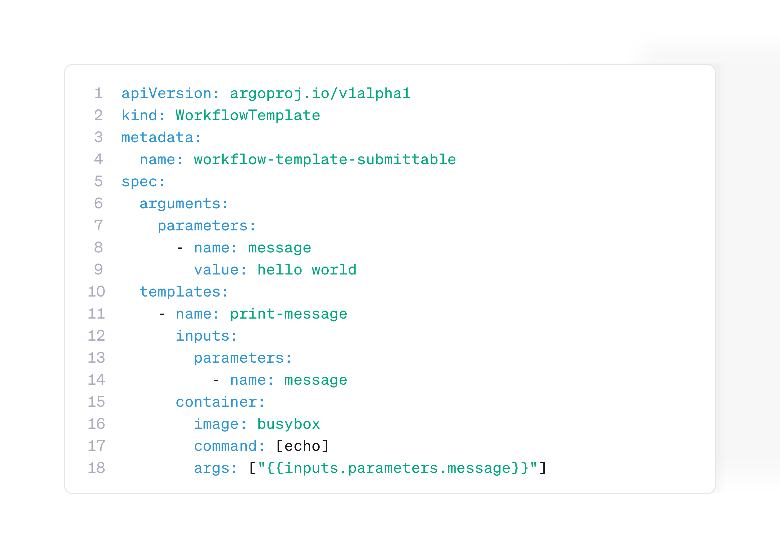





3
The Battle
Rise of Argo
Argo by Konstantinos Volanakis
The Weapons
Meet the Hero
Argo brings order through a powerful set of tools:
Argo Workflows
Workflow Controller
WorkflowTemplates
Open source
Container-native
Kubernetes based
Cloud agnostic
Steps, DAG
Artifacts
Parameters
UI/CLI
Notes:
Argo Workflows is an open-source, container native, kubernetes based, cloud agnostic workflow engine. This means that Argo can orchestrate workflows in a Kubernetes Clúster, which can be deployed to any cloud platform that supports Kubernetes.

Slide 17
The Weapons
Argo brings order through a powerful set of tools:
Workflow Controller
WorkflowTemplates
Steps, DAG
Artifacts
Parameters
UI/CLI
Notes:
Argo Workflows is packed with a set of powerful tools, such as:

Slide 18
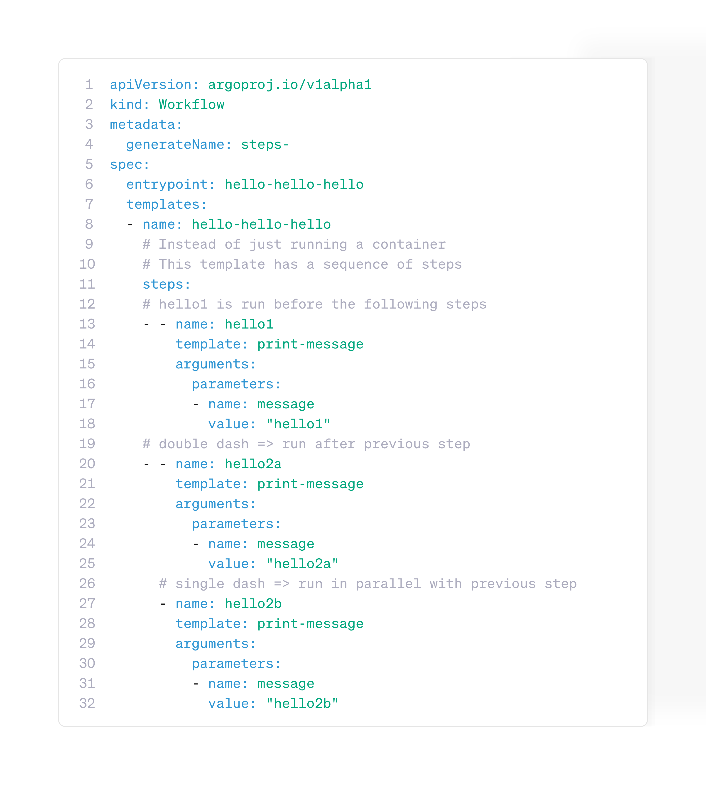
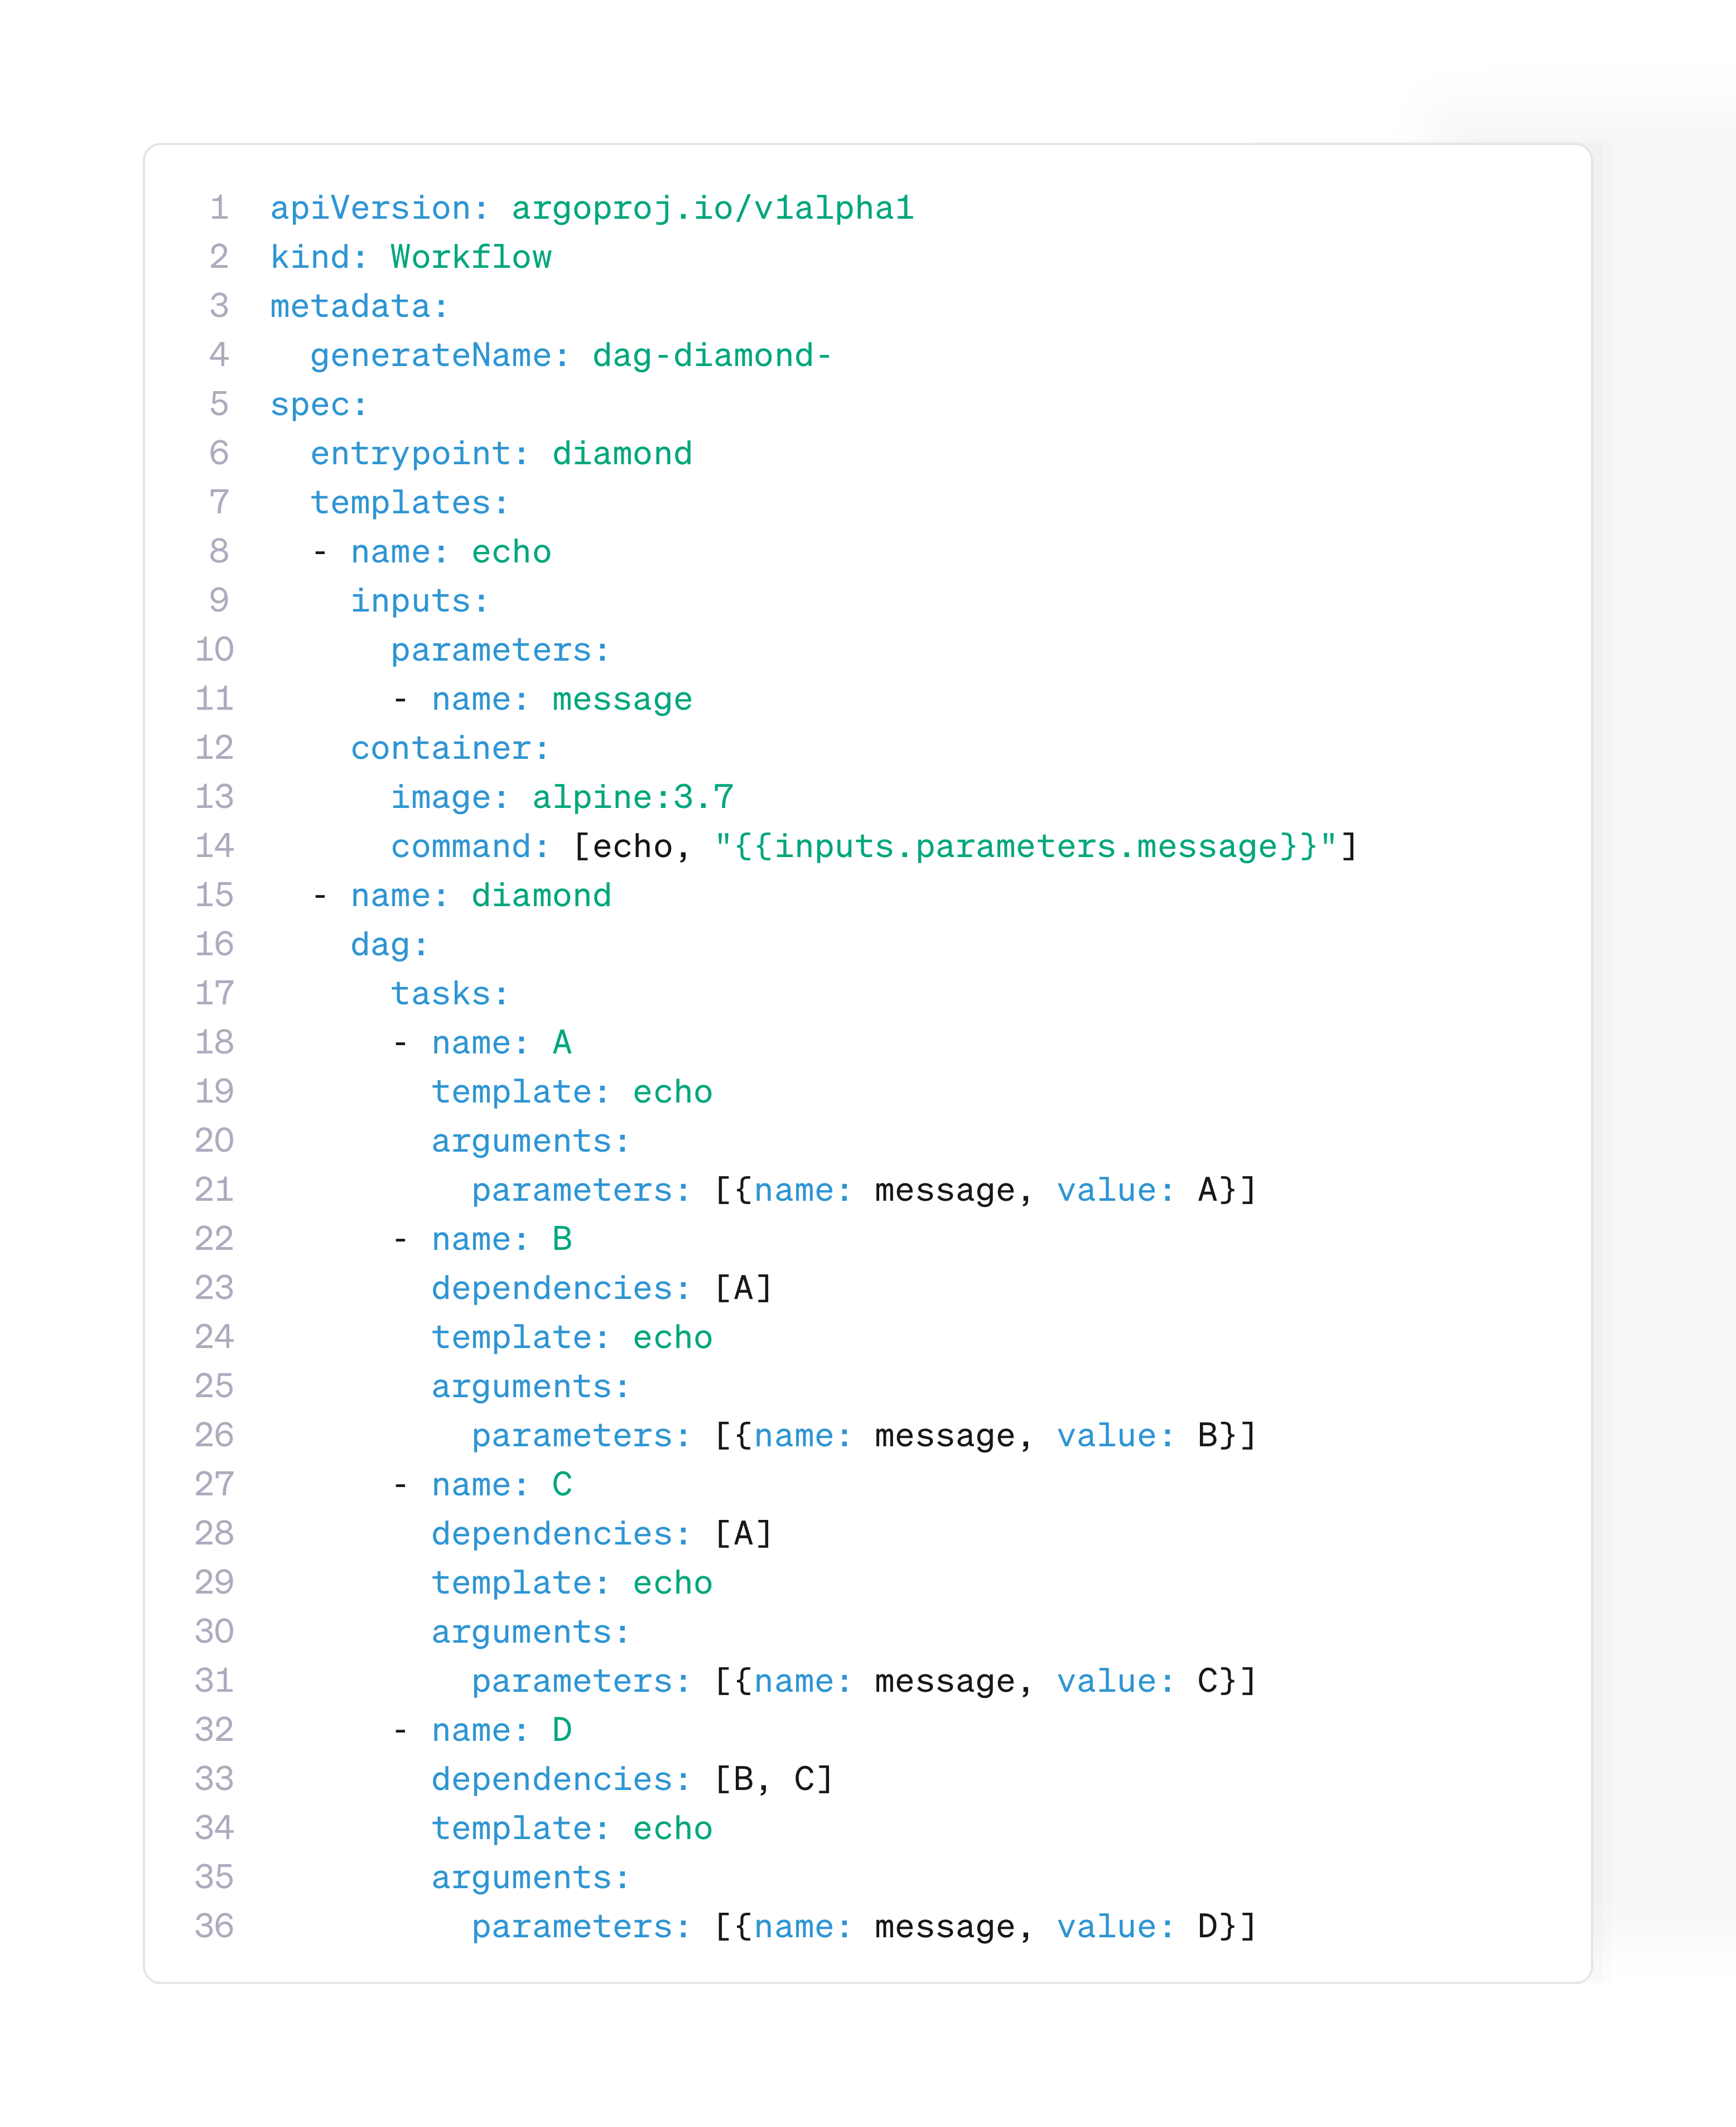
The Weapons
Argo brings order through a powerful set of tools:
DAG
Steps
Artifacts
WorkflowTemplates
Parameters
Workflow Controller
UI/CLI
Notes:
The Workflow Controller is at the core, orchestrating all the workflow tasks, managing retries, enforcing dependencies, tracking metrics, and handling the flow of artifacts between steps.
WorkflowTemplates make it possible to define reusable and versionable blueprints, so teams can share and standardize automation patterns.

Slide 19
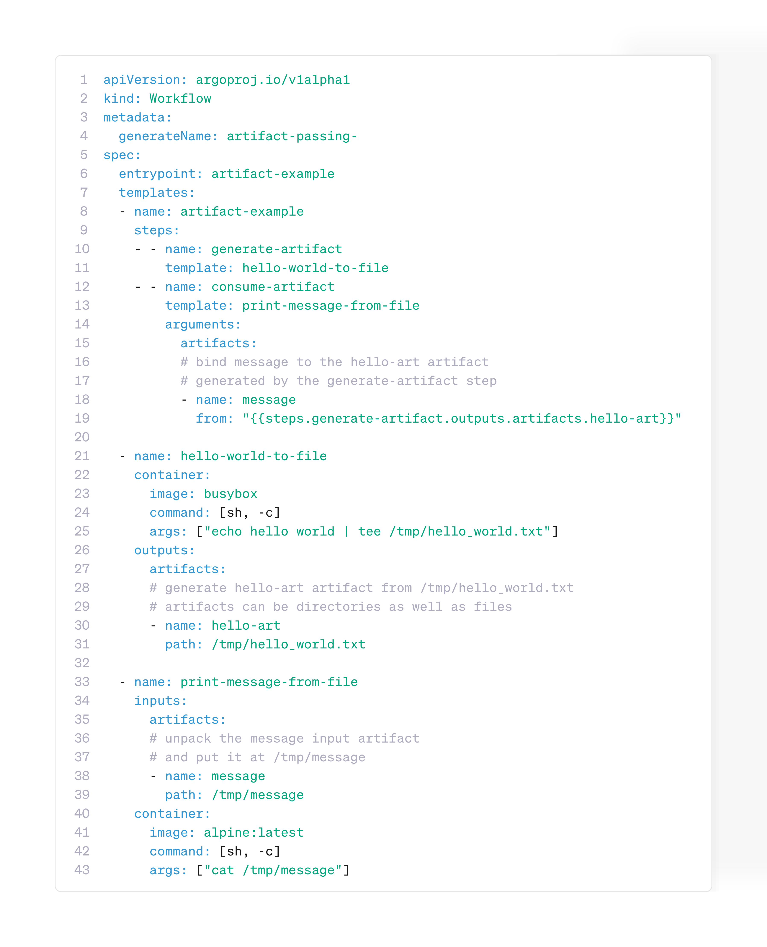
The Weapons
Parameters
Artifacts
Workflow Controller
WorkflowTemplates
Steps
DAG
UI/CLI
Notes:
Workflows can be defined as simple sequential steps, or as DAGs, directed acyclic graphs, which allow parallel execution and more complex dependencies.

Slide 20
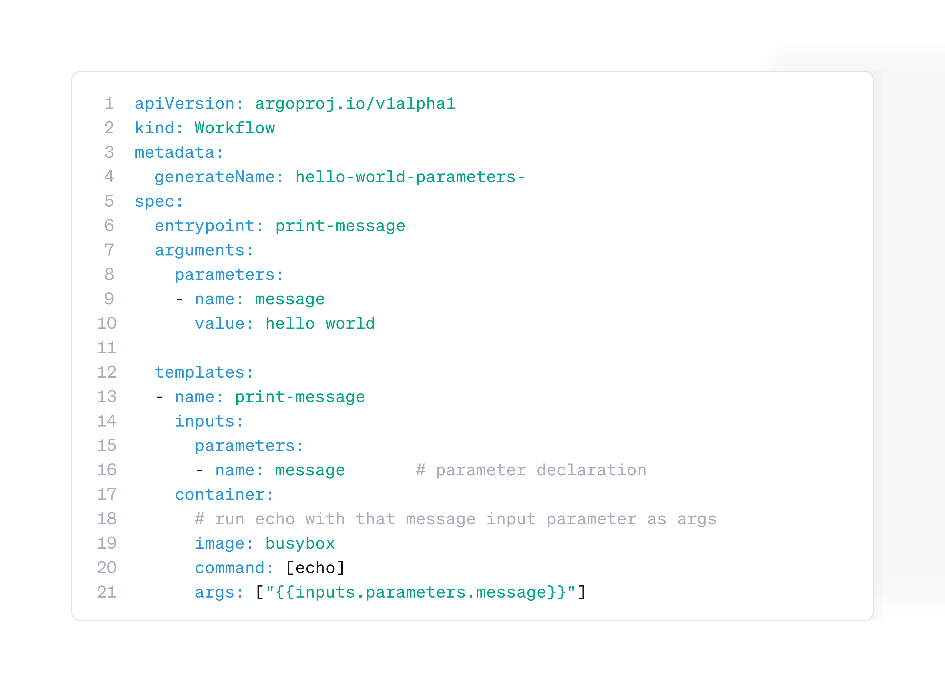
The Weapons
Parameters
Steps
DAG
Artifacts
UI/CLI
Notes:
Artifact management enables tasks to exchange files or data, with native support for S3-compatible object stores like MinIO or AWS S3.

Slide 21
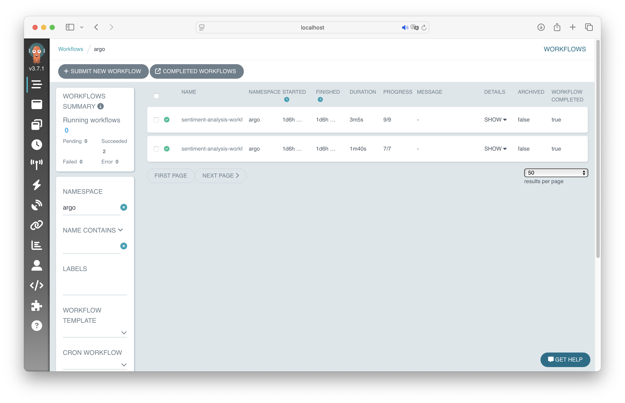
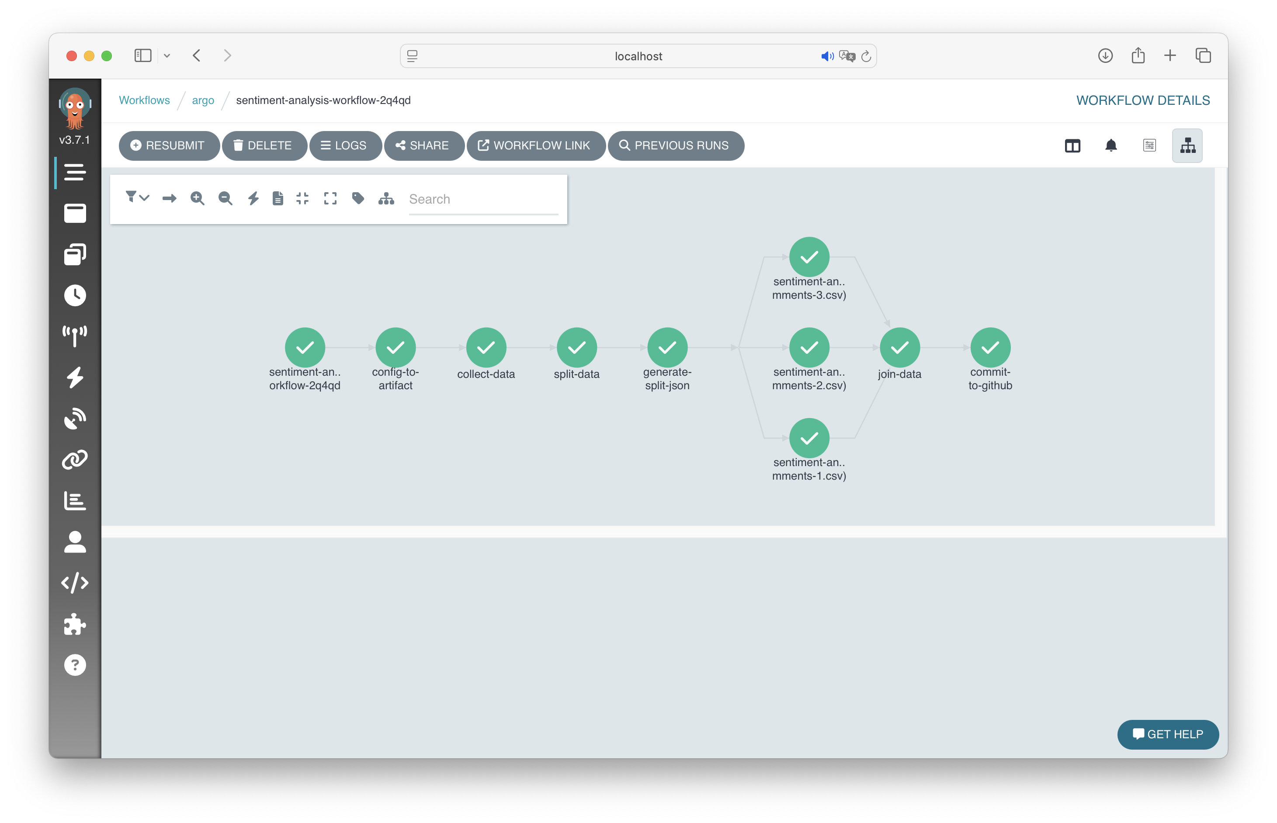
The Weapons
UI
CLI
Steps, DAG
Artifacts
Parameters
Notes:
Parameters allow the passing of information between steps, whether as text, objects, or files, which makes the workflows flexible for both lightweight and data-heavy tasks.

Slide 22
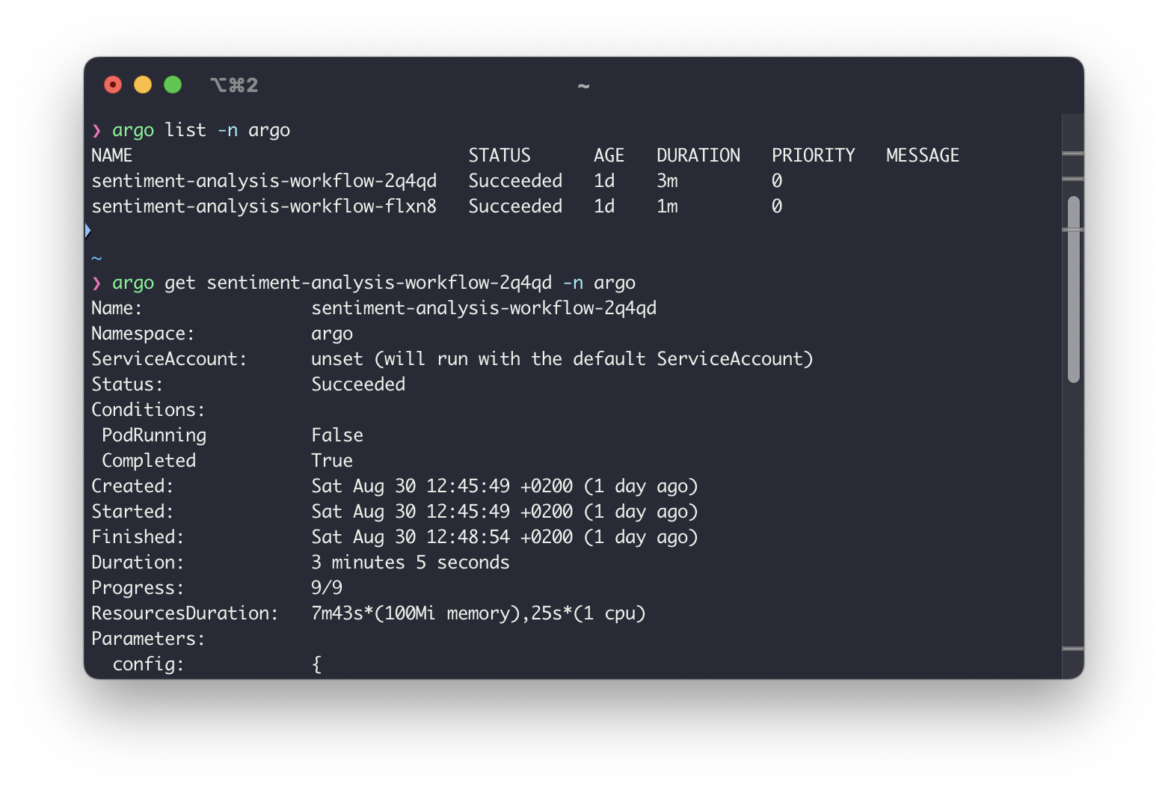
The Weapons
Parameters
UI
CLI
Notes:
The system comes with a powerful UI and CLI, making it easy to submit, monitor, visualize, and debug workflows.
And finally, Argo includes advanced features like conditional logic, looping, event-driven triggers through Argo Events, and the ability to run recurring workflows on a schedule.

Slide 23

The Weapons
Not
Not
a streaming engine (like Kafka, Flink, etc.)
ideal for ultra-low latency tasks
Not
Not
What Argo is not
a database or state store
a replacement for serverless platforms (but integrates well)
UI
CLI
Notes:
Incluir ejemplos/capturas de pantalla y animaciones

Slide 24
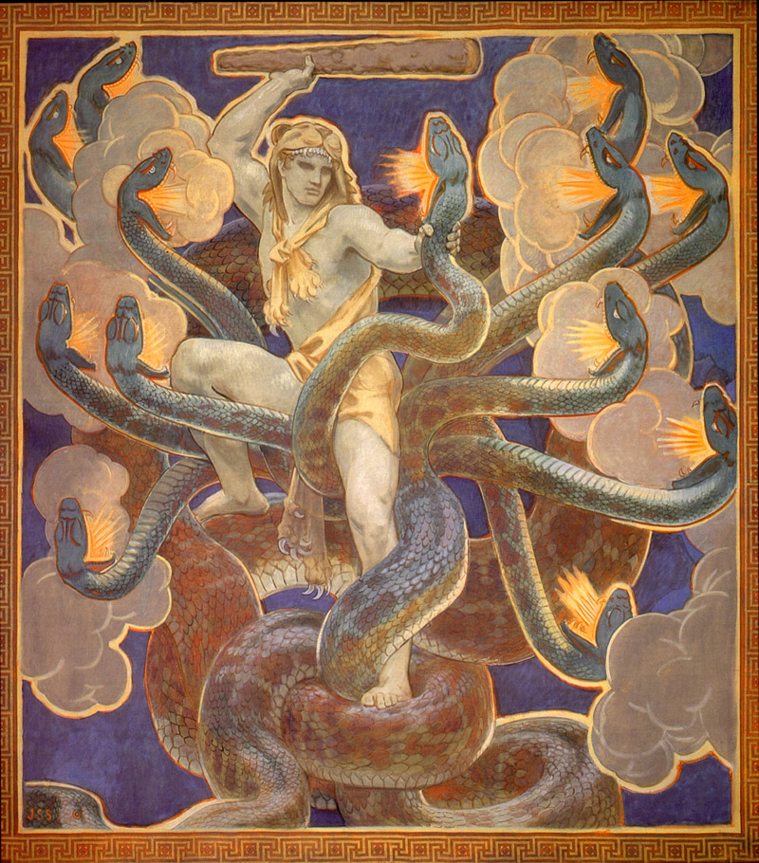
The Weapons
CLI
4
Not
Not
a streaming engine (like Kafka, Flink, etc.)
ideal for ultra-low latency tasks
Not
Not
The Three Labors
Image Classification
Machine Learning Training
Sentiment Analysis
What Argo is not
a database or state store
a replacement for serverless platforms (but integrates well)
Notes:
Argo Workflows is ideal for automating workflows. But it’s important to be clear about what it’s not. It’s not a streaming engine, so it’s not designed for ultra-low-latency execution. It’s not a database or a state store, although it can integrate with those when needed. And it’s not a replacement for serverless platforms or event-based architectures. Instead, it complements them and integrates very well with them.

Slide 25

4
Not
Not
a streaming engine (like Kafka, Flink, etc.)
ideal for ultra-low latency tasks
Not
Not
The Three Labors
Image Classification
Machine Learning Training
Sentiment Analysis
What Argo is not
a database or state store
a replacement for serverless platforms (but integrates well)
Image classification
Download images
Pre-process images
Process images
Classify images
Upload results
Image classification workflow
Notes:
I want to walk you trough what I call The Three Labors. Each Labor is a real-world automation challenge, but it's simplified into a form that is easy to understand but powerful enough to demonstrate the benefits of Workflow Orchestration

Slide 26
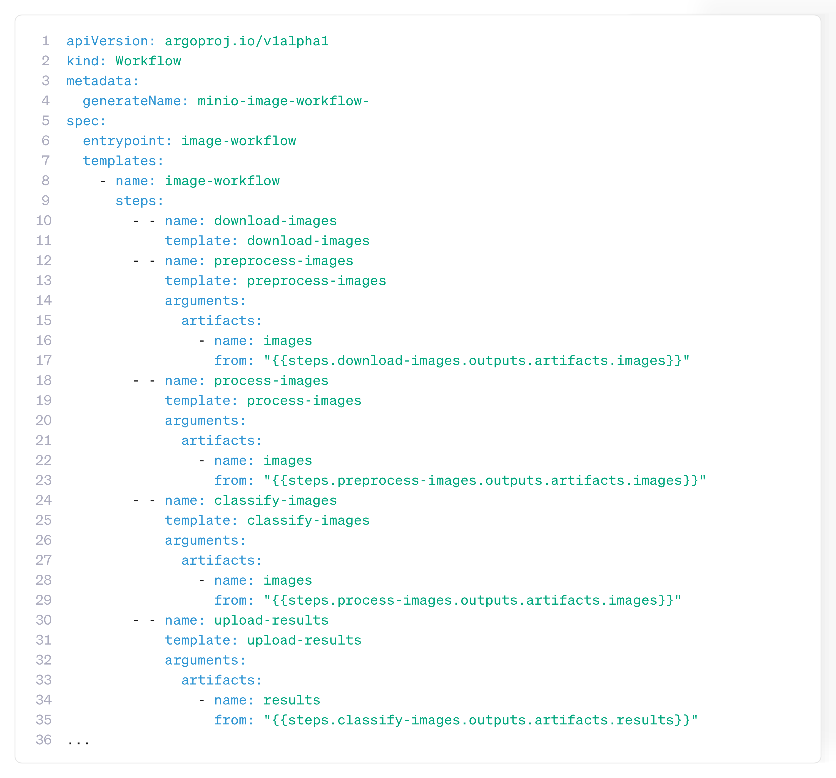
4
The Three Labors
Image Classification
Machine Learning Training
Sentiment Analysis
Image classification
Download images
Pre-process images
Process images
Classify images
Upload results
Image classification workflow
Notes:
The first labor is Image Classification. Imagine you’re handed not one but hundred of images, all need to be processed and classified. On its own, it sounds like a repetitive, error prone task. Workflow Orchestration is the ideal solution for scenarios like this. Once the workflow is setup, Argo handles the journey, each image goes trough preprocessing, processing, classification and aggregation of results. Argo handles the step execution, keeps tracks of artifacts and guarantees reproducibility for each step.

Slide 27
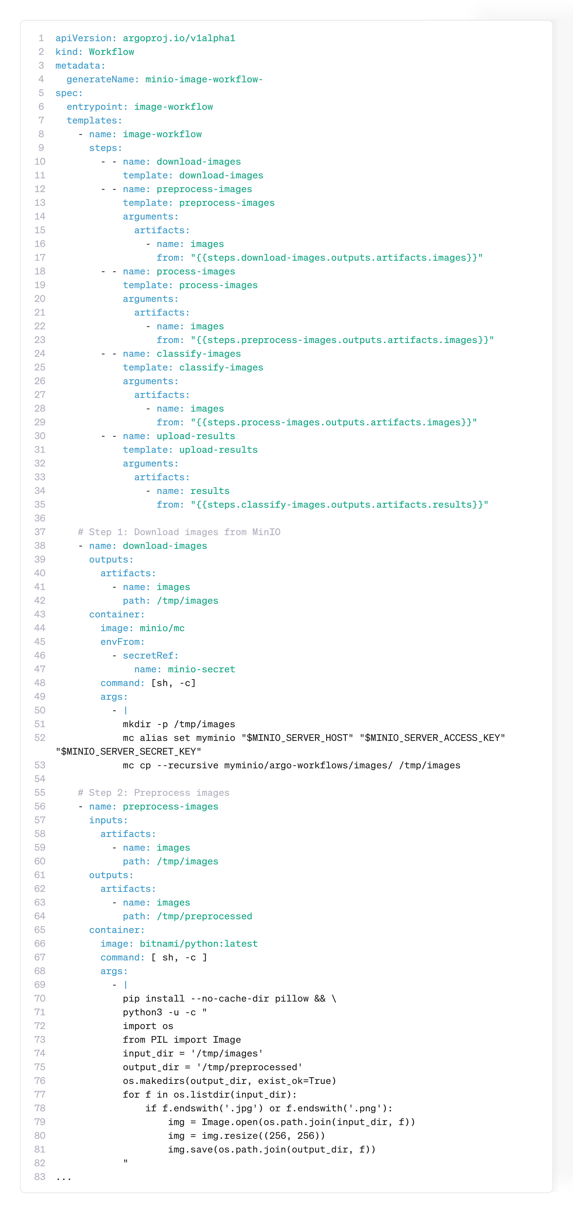
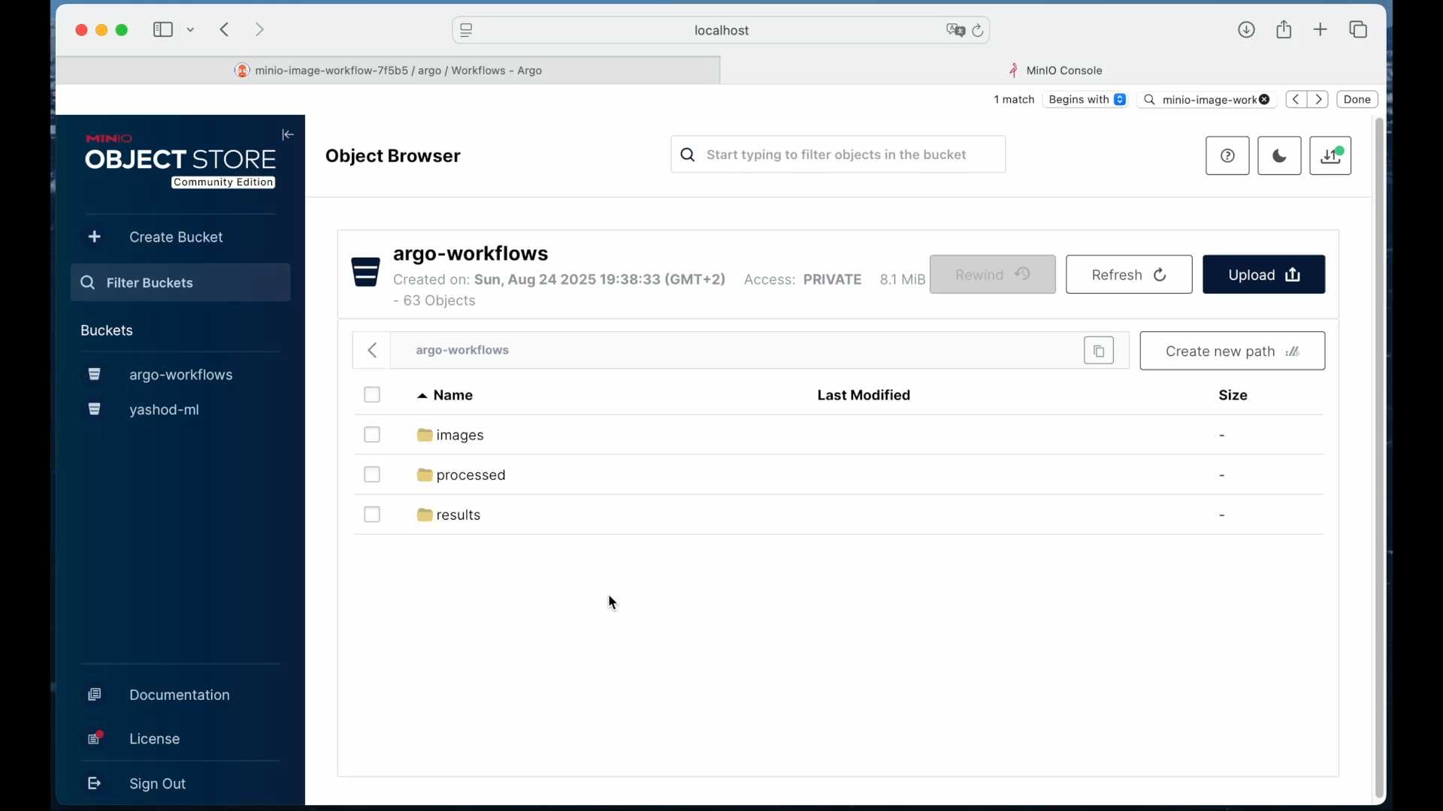
Image classification
Download images
Pre-process images
Classify images
Process images
Upload results
Notes:
DONE

Slide 28

Image classification
Download images
Pre-process images
Classify images
Process images
Upload results
Machine learning training
1
Train until accuracy
If accuracy <87% and iteration <5
2
Accuracy Loop
Train model
Evaluate accuracy
Upload if accuracy is 75%
Train until accuracy
3
Looping section of the workflow. (Perera, 2024)
Notes:
DONE

Slide 29
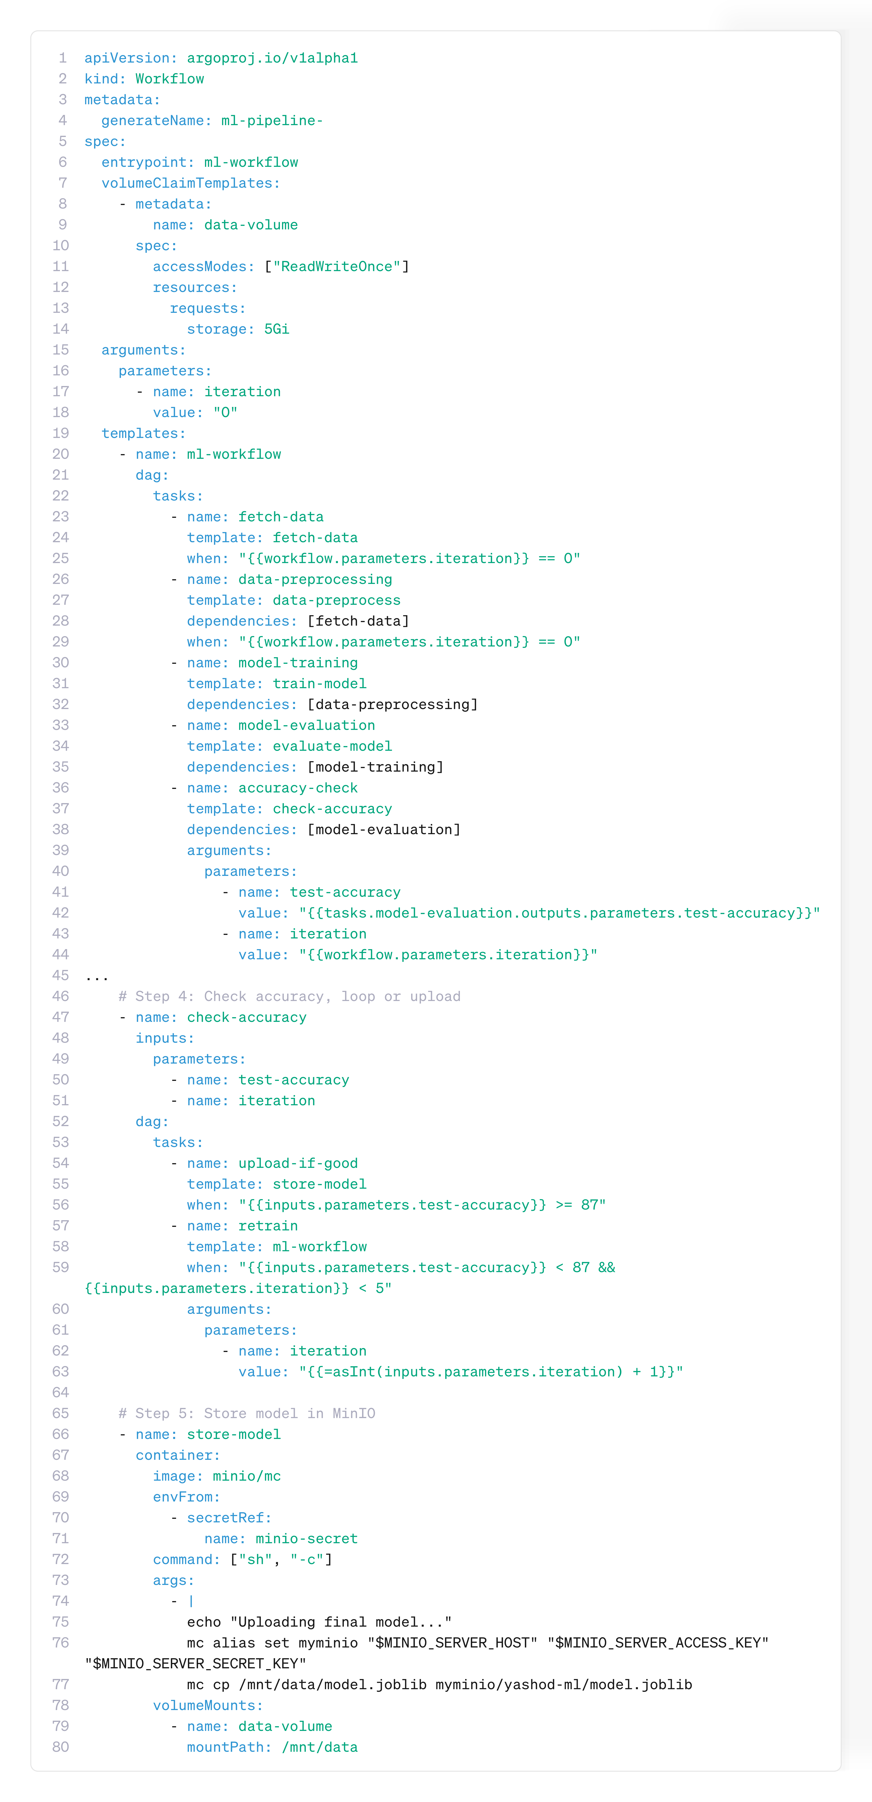
Machine learning training
1
Train until accuracy
If accuracy <87% and iteration <5
2
Accuracy Loop
Train model
Evaluate accuracy
Upload if accuracy is 87%
Train until accuracy
3
Looping section of the workflow. (Perera, 2024)
Notes:
The second labor raised the stakes: Machine Learning Training. Here Argo orchestrates a ML pipeline, from data ingestion, cleaning, model training, validation, and deployment. Each of these tasks could live in different environments, CPUs for preprocessing, GPUs for training, or even separate cloud services. Argo ties them together in one coherent workflow. What was once a set of scripts now becomes a repeatable experiment, and every run is traceable, reproducible and scalable.

Slide 30
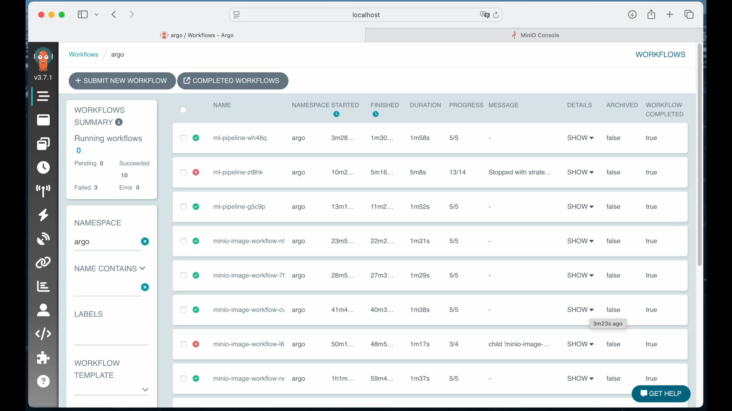
Machine learning training
1
2
Train until accuracy
If accuracy <87% and iteration <5
Train model
Evaluate accuracy
Accuracy Loop
Upload if accuracy is 87%
Train until accuracy
3
Notes:
Looping section of the workflow. (Perera, 2024)

Slide 31

Sentiment analysis
Machine learning training
Sentiment analysis with RoBERTa
1
Train until accuracy
Collect Reddit comments
Divide comments file
Sentiment analysis with RoBERTa
Unify resulting files
Data
Train model
Evaluate accuracy
visualization
…
Sentiment analysis with RoBERTa
Accuracy Loop
Upload if accuracy is 75%
Train until accuracy
n
Sentiment analysis workflow
Notes:
Cada diapositiva de labor tiene: 1 diagrama, 1 snippet y 1 video

Slide 32
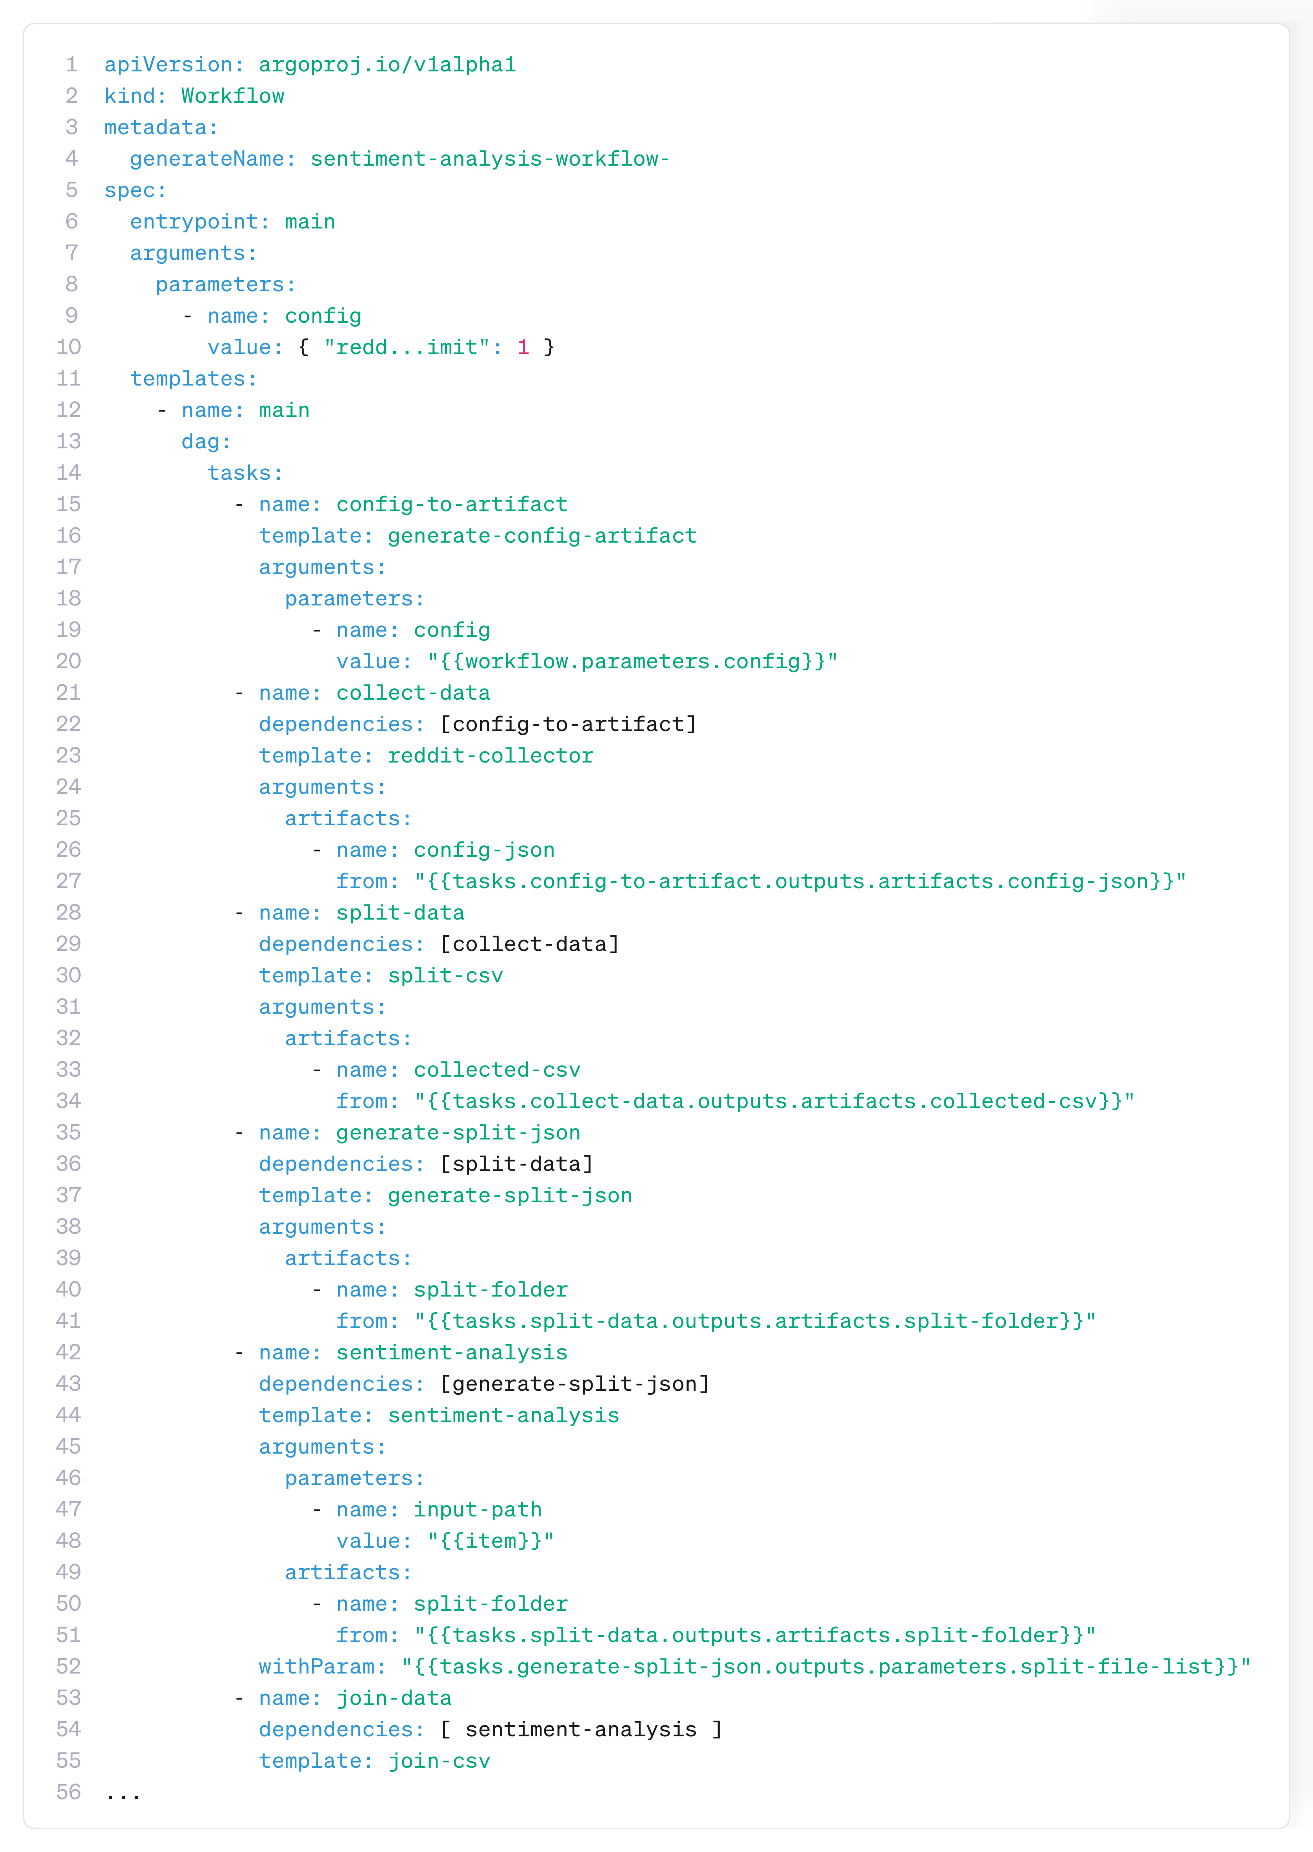
Sentiment analysis
Sentiment analysis with RoBERTa
1
Collect Reddit comments
Divide comments file
Sentiment analysis with RoBERTa
Unify resulting files
Data
visualization
…
Sentiment analysis with RoBERTa
n
Sentiment analysis workflow
Notes:
The third labor takes us from pixels to words: Sentiment Analysis of social media conversations. A pipeline that collects Reddit comments on specific topics, cleans and process the text, extracts topics, and finally classifies the sentiments of each discussion. This labor proves that Argo can orchestrate complex text mining workflows and deliver insights at scale.

Slide 33
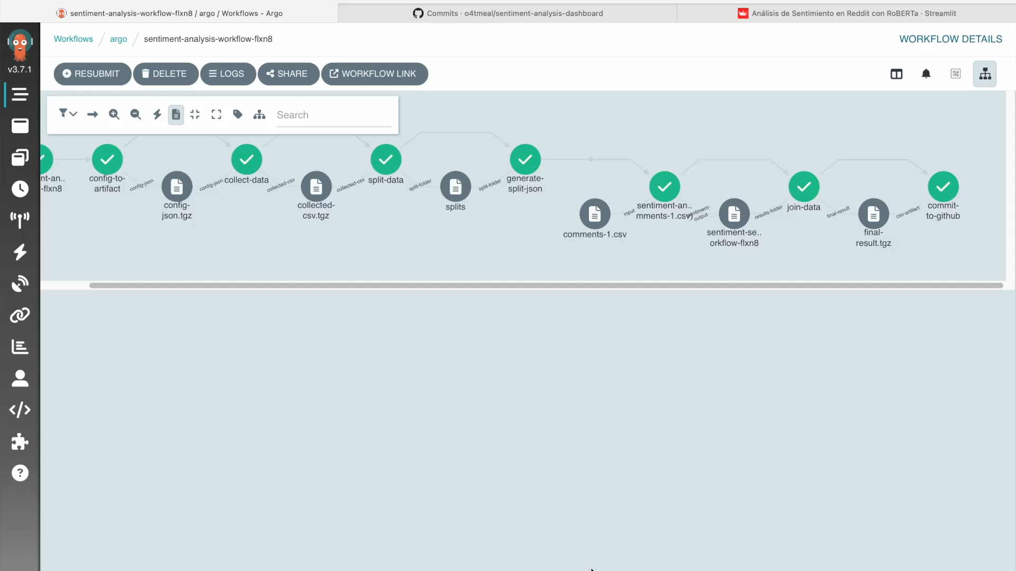
Sentiment analysis
Collect Reddit comments
Divide comments file
1
…
n
Data
Unify resulting files
visualization
Notes:
Nombrar diagrama

Slide 34
Sentiment analysis
Collect Reddit comments
Divide comments file
1
…
n
Data
Unify resulting files
visualization
Notes:
Cada diapositiva de labor tiene: 1 diagrama, 1 snippet y 1 video

Slide 35
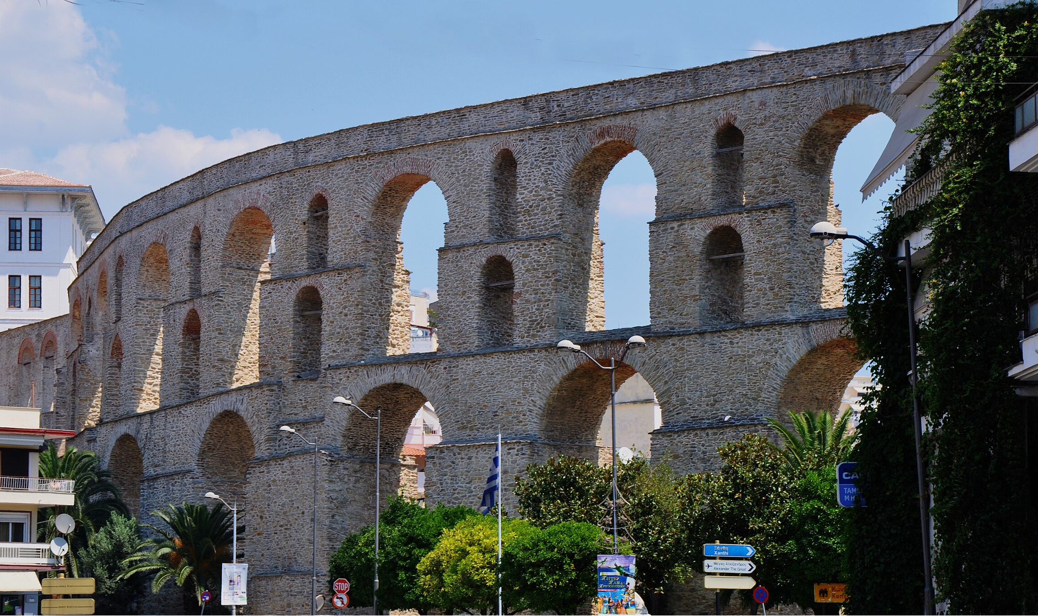

5
After the battle order reigns. What was once chaos now flows seamlessly, is reliable, visible, and automated.
The Flow
Harmony Restored
Automated workflows…
01
02
03
Bring consistency and reliability
Give you scalability and efficiency
Provide visibility and traceability
04
05
Allow for integration and automation
Save time and costs
Notes:
Once the battle against Chaos is over, we can enjoy the sweet harmony of order. Let's go over the benefits of having automated workflows.

Slide 36
5
The Flow
Harmony Restored
Checklist: Do I need a workflow orchestrator?
Automated workflows…
Simple scripts:
Few steps
Minimal dependencies
Low change rate
Event-driven system:
Tasks are short-lived
Triggered by external events
Near-real-time
Workflow Management System:
Multiple steps with dependencies
Need retries & consistent error handling
Requiere artifact/data passing
Require observability & auditability
01
02
03
Bring consistency and reliability
Give you scalability and efficiency
Provide visibility and traceability
04
05
Allow for integration and automation
Save time and costs
Notes:
Some of the most notable results for automated workflows are:
The ability to visualize the progress and access logs, artifacts and parameters at each step in a centralized platform
Letting the platform manage error handling and configurable automatic retries
Achieve scalable workflows by design
Having reusable workflows, that can be easily shared and versioned by a team
Having cost efficient solutions

Slide 37
Orchestrator comparison
Orchestrator | Argo Workflows | Airflow | AWS Step | Temporal
Environment | Kubernetes-native | Python + Scheduler | Fully managed | Self-hosted/ Managed
Best for | Cloud-native, CI/CD, ML pipelines | Data pipelines | Cloud-native apps in AWS | Durable long-running workflows
Ease of start | Medium (needs K8s) | Easy (Python DAGS) | Easy (visual + JSON/YAML) | Medium (SDKs, infra)
Cost | Infra only | Infra + ops | Pay-per-state transition | Infra +ops
Observability | UI +K8s logs/metrics | Limited UI | AWS CloudWatch | Built-in tracing/logs
Lock-in | Low | Low | High (AWS only) | Medium
Checklist: Do I need a workflow orchestrator?
Automated workflows…
Simple scripts:
Few steps
Minimal dependencies
Low change rate
Event-driven system:
Tasks are short-lived
Triggered by external events
Near-real-time
Workflow Management System:
Multiple steps with dependencies
Need retries & consistent error handling
Requiere artifact/data passing
Require observability & auditability
01
02
03
Bring consistency and reliability
Give you scalability and efficiency
Provide visibility and traceability
04
05
Allow for integration and automation
Save time and costs
Notes:
With all this information in hand, it’s a good moment to pause and ask ourselves, do I need a workflow orchestrator? I wanted to share a checklist that helps you identify if a Workflow Management System could help your particular use case:
If your workflow has few steps, minimal dependencies and a low change rate, it’s possible that you might do just fine with simple scripts.
If your tasks are short lived, event-based and needs near real-time response, an Event-driven system might be a better choice
But if your workflow has multiple steps with dependencies, need retries and consistent error handling to ensure completion, integrates artifact and data passing, and requires granular observability and auditability, a Workflow Management System might be a good choice for you

Slide 38
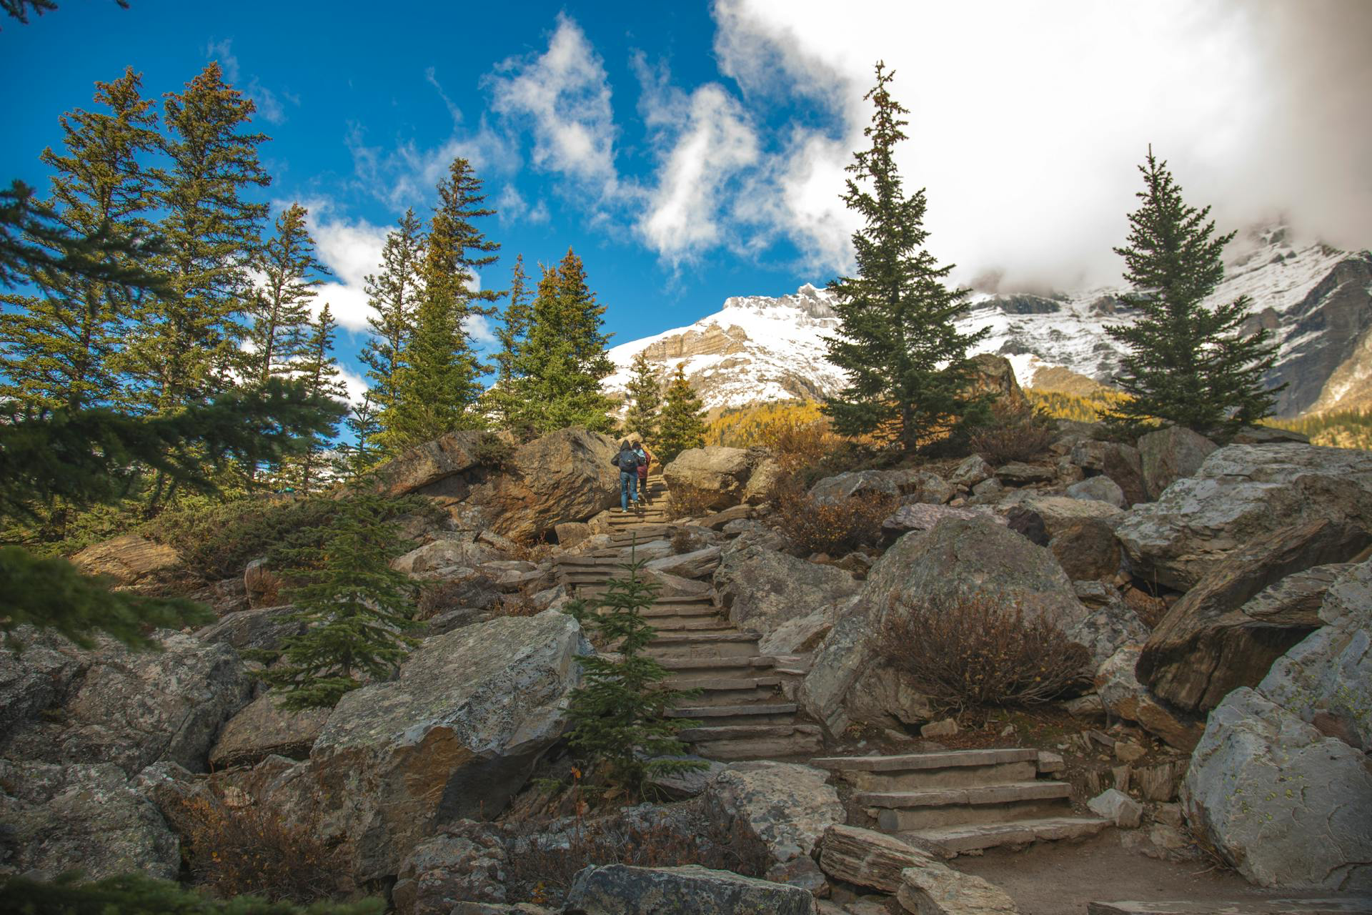
Orchestrator comparison
6
Orchestrator | Argo Workflows | Airflow | AWS Step | Temporal
Environment | Kubernetes-native | Python + Scheduler | Fully managed | Self-hosted/ Managed
Best for | Cloud-native, CI/CD, ML pipelines | Data pipelines | Cloud-native apps in AWS | Durable long-running workflows
Ease of start | Medium (needs K8s) | Easy (Python DAGS) | Easy (visual + JSON/YAML) | Medium (SDKs, infra)
Cost | Infra only | Infra + ops | Pay-per-state transition | Infra +ops
Observability | UI +K8s logs/metrics | Limited UI | AWS CloudWatch | Built-in tracing/logs
Lock-in | Low | Low | High (AWS only) | Medium
The Paths Beyond
A New Era of Automation
Checklist: Do I need a workflow orchestrator?
Simple scripts:
Few steps
Minimal dependencies
Low change rate
Event-driven system:
Tasks are short-lived
Triggered by external events
Near-real-time
Workflow Management System:
Multiple steps with dependencies
Need retries & consistent error handling
Requiere artifact/data passing
Require observability & auditability
Notes:
When choosing a tool for workflow management, there are conditions to consider, here we can see some of the options available today. I contemplated some of these tools for my masters final project, they are powerful tools that offer many advantages on their own. However, there is not one-case-fits-all, and the best choice would be the one that fits better for you. Are you looking for a fully managed tool that can orchestrate workflows self contained on AWS? AWS Step Functions may be right for you. Are you more interested in a SDK approach where you can define your workflows as code? Temporal offers that. Airflow is great for data pipelines and great for cron-scheduling. In the end, it’s not about the most powerful tool — it’s about the tool that fits your needs, your team, and your workflows. Choose what works for your story.

Slide 39


Orchestrator comparison
6
Orchestrator | Argo Workflows | Airflow | AWS Step | Temporal
Environment | Kubernetes-native | Python + Scheduler | Fully managed | Self-hosted/ Managed
Best for | Cloud-native, CI/CD, ML pipelines | Data pipelines | Cloud-native apps in AWS | Durable long-running workflows
Ease of start | Medium (needs K8s) | Easy (Python DAGS) | Easy (visual + JSON/YAML) | Medium (SDKs, infra)
Cost | Infra only | Infra + ops | Pay-per-state transition | Infra +ops
Observability | UI +K8s logs/metrics | Limited UI | AWS CloudWatch | Built-in tracing/logs
Lock-in | Low | Low | High (AWS only) | Medium
The Paths Beyond
A New Era of Automation
Epilogue
Questions?
Thank you for your time!
If you'd like recommendations on documentation for the Argo ecosystem or beyond basic workflows, feel free to check out my GitHub ( ˆ ᴗ ˆ) .ᐟ.ᐟ
Notes:
By now, we have seen what Argo can do, the benefits of having automated, managed workflows. Now the paths that lie beyond us are open, from orchestrating serverless functions, run AI pipelines at scale, integrate across cloud platforms, etc.

Slide 40
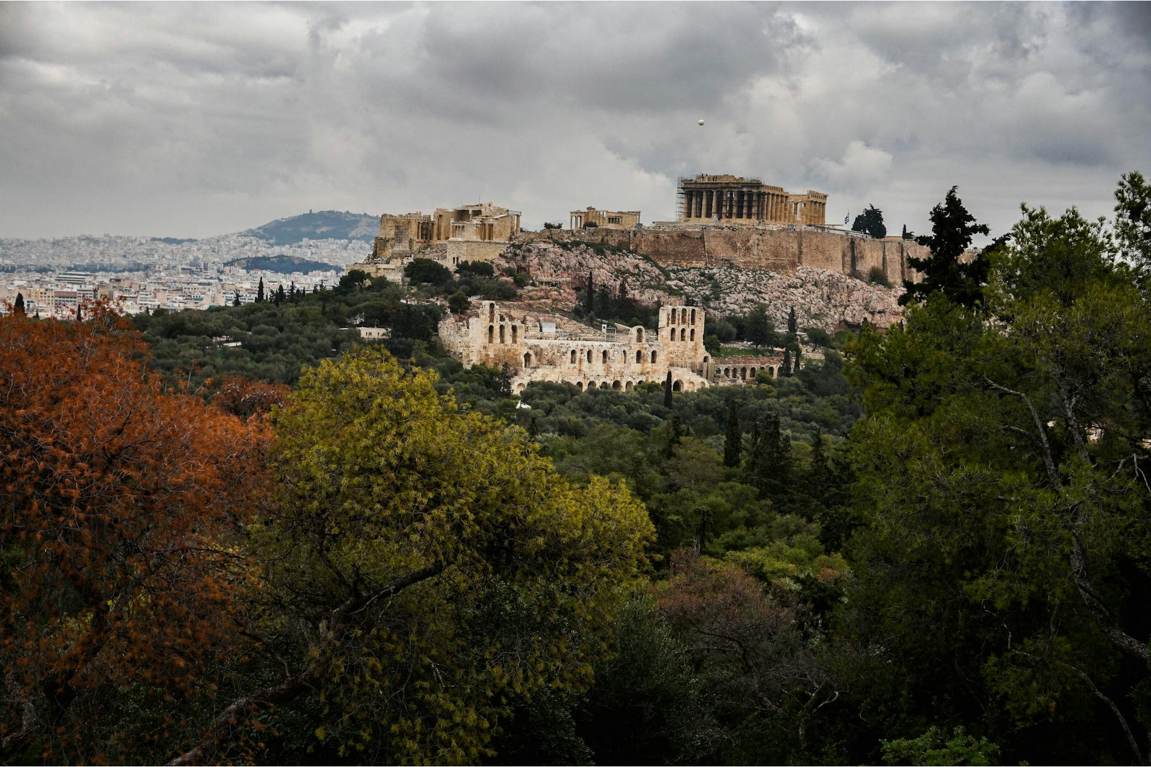
6
Epilogue
Questions?
Thank you for your time!
If you'd like recommendations on documentation for the Argo ecosystem or beyond basic workflows, feel free to check out my GitHub ( ˆ ᴗ ˆ) .ᐟ.ᐟ
The Paths Beyond
A New Era of Automation
www.avantio.com
Notes:
DONE

Slide 41
Thank you for your time!
If you'd like recommendations on documentation for the Argo ecosystem or beyond basic workflows, feel free to check out my GitHub ( ˆ ᴗ ˆ) .ᐟ.ᐟ
www.avantio.com
Notes:
Actualizar QR

Slide 42
Implementing Argo Workflows in OSCAR
Notes:
I would like to do a quick mention of my final project use case, I basically implemented Argo Workflows as a Serverless Workflow Management System that allowed to orchestrate workflows by connecting with OSCAR, an open source platform that supports event-driven computing model to execute services on demand. Here, Argo didn’t execute the services by itself, but orchestrated the services execution through the interfaces that OSCAR exposes, adding all the capabilities of workflow orchestration to OSCAR. This opens paradigms where you might want to orchestrate workflows in multi-cloud environments, hybrid environments or even in a computing continum architecture.

Slide 43



Undestanding the cost of Argo Workflows
Lightweight control plane, runs a few pods
Each step runs as a Kubernetes pod. Costs scale with CPU, memory & GPU
Artifacts/logs stored in S3/GCS/etc. +egress charges for data transfers
Negligible
Major
Minimal cost
Main cost driver
Can surprise you
Hidden costs
Argo Controller & UI
Workflow Pods
Storage & Networking
You pay for the workloads, not the orchestrator
Notes:
Looping section of the workflow. (Perera, 2024)

Slide 44

Security in Argo Workflows
RBAC, namespaces, ServiceAccounts
Secrets from Vault/K8s, encrypted storage
Pod security, audit logs, multi-tenant safety
Access control
Data protection
Isolation & compliance
Argo leverages Kubernetes security
Notes:
Looping section of the workflow. (Perera, 2024)

